Slide 1


Hvorfor og hvordan skal vi forske i feltet ‘global mental helse (GMH)’
Eksempler fra Global Mental Health Research Group in Bergen
Ingunn Marie Stadskleiv Engebretsen
Professor, Centre for International health
Ingunn.Engebretsen@uib.no
Office: 55588553 Mobile: 97765015

Slide 2

SDG 3: Good health and wellbeing

Slide 3


Slide 4
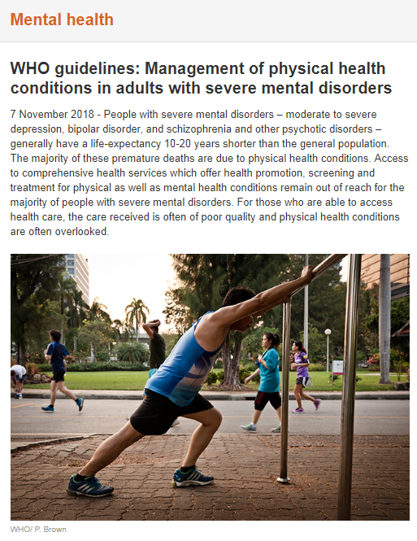
SDG 3’s strong focus on GMH
3.4 By 2030, reduce by one third premature mortality from non-communicable diseases through prevention and treatment and promote mental health and well-being
3.5 Strengthen the prevention and treatment of substance abuse, including narcotic drug abuse and harmful use of alcohol

Slide 5
Consider the full focus on health systems
3. 8 Achieve universal health coverage, including financial risk protection, access to quality essential health-care services and access to safe, effective, quality and affordable essential medicines and vaccines for all

Slide 6
6 KEY actions
The Commission fully recognises the diversity of settings across countries and within countries and suggests that the starting point for staged implementation of its recommendations will differ according to particular settings and the availability of human and financial resources.

Slide 7
1. UHC
“First, mental health services should be scaled up as an essential component of universal health coverage and should be fully integrated into the global response to other health priorities, including non-communicable diseases, maternal and child health, and HIV/AIDS. Equally, the physical health of people with severe mental disorders should be emphasised in such integrated care.”
UHC
  Integration into somatic health care services
  Somatic health care services strengthened

Slide 8
2. Barriers – threats and awareness
“Second, barriers and threats to mental health need to be addressed; these include the lack of awareness of the value of mental health in social and economic development, the lack of attention to mental health promotion and protection across sectors, the severe demand-side constraints for mental health care caused by stigma and discrimination, and the increasing threats to mental health due to global challenges such as climate change and growing inequality. “
  Demand side
  Stigma and discrimination

Slide 9
3, 4, 5: Opportunities, investments
3: Public policy
4: New opportunities should be embraced
non-specialist individuals and digital technologies
mobilisation of the voices of people with lived experience of mental disorders
5: Additional investments should be made urgently
efficient and effective use of existing resources—for example, through the redistribution of mental health budgets
introduction of early interventions for emerging mental disorders
re-allocation of budgets for other health priorities to promote integration of mental health care in established platforms of delivery

Slide 10
6. Innovation and research
Investments in research and innovation
diverse disciplines such as genomics, neuroscience, health services research, clinical sciences, and social sciences
implementation research on scaling up mental health interventions and for discovery research to advance understanding of causes and mechanisms of mental disorders and develop effective interventions to prevent and treat them

Slide 11
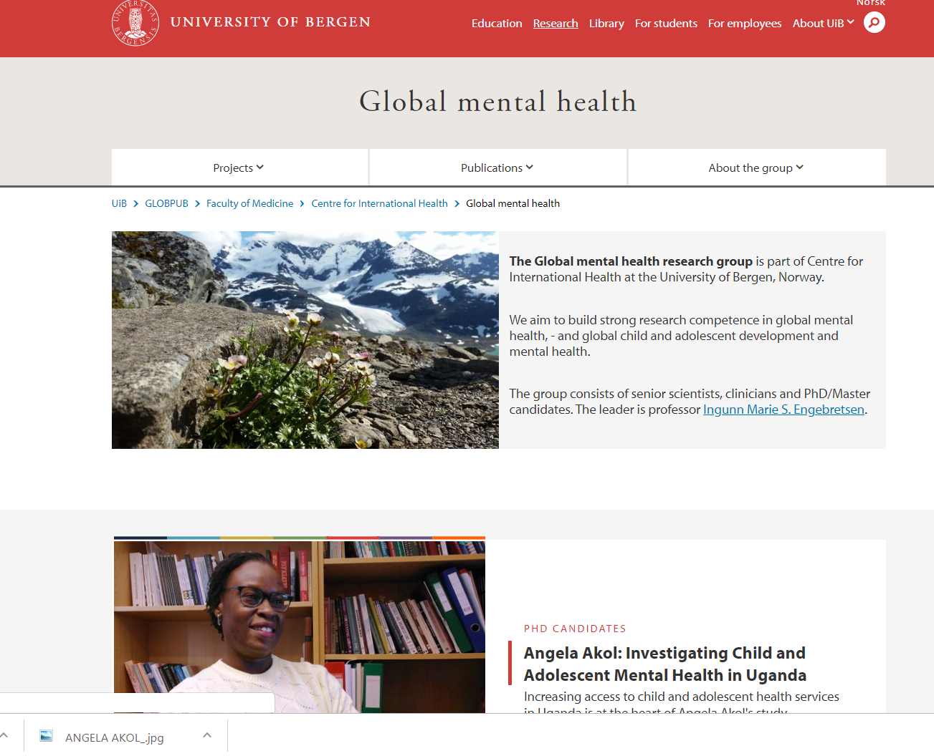
Who we are: The global mental health research group
Vision:
“The Global mental health research group aims to build strong research competence in global mental health and global child and adolescent mental health.”
The group consists of senior scientists, clinicians and PhD/Master candidates.

Slide 12

Cross-cultural understanding
Language
  Classification terms do not exist/are difficult to translate
    E.g. Depression = World problems
  Concepts are “foreign”
    Hyperactivity = “bright”
  Realities which are difficult are not embraced by the diagnostic system (lack of relevance)
    Substance abuse in minors

Slide 13
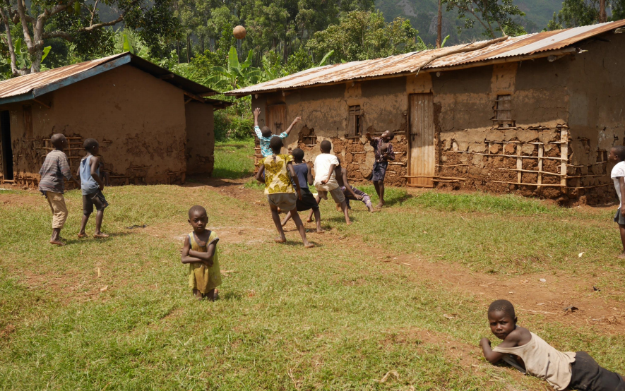

Research response 1
"Are mental health problems in children being neglected? Preliminary results from SeeTheChild – Mental Child Health in Uganda“
  Opportunities in Master Theses, research track
  Cheap, explorative
  Opportunities for larger
  cross-disciplinary/
  cross-cultural collaboration
Vilde Skylstad

Slide 14
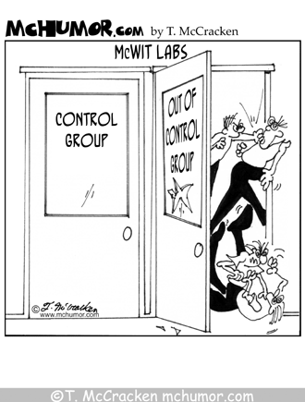
Public policy and research response I
-> Health system research (HSR)
-> Intervention research
- efficacy trials
-> Implementation research
- addressing the KNOW-DO gap

Slide 15
The clinical/field trials pathway:
production
GMP
Phase I
Trials
Basic
research
Phase II
Trials
Biological Response
Safety
Phase III
Trials
Phase IV
studies
pipeline:
- industry
- public research institutions
- others
Efficacy/Effectiveness
_{PULL}
Clinical/Field trials: Critical instrument from product development to implementation and thereby for product development
15
Notes:
15

Slide 16
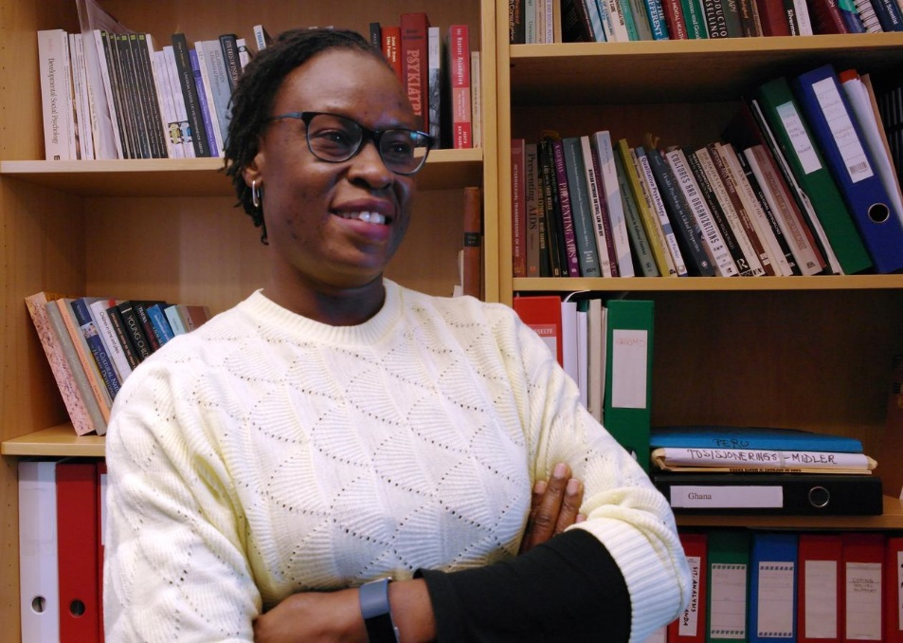
HSR
“Investigating Access to Child and Adolescent Mental Health Services in Uganda” A. Akol
-> Policy
-> Health system
  Intervention
  Implementation

Slide 19
Results from an clinic RCT training in mhGAP

Slide 20
Public policy and research response II
-> Health system research
-> Intervention research
- Efficacy trials
-> Implementation research
- Addressing the KNOW-DO gap
- Studies of implementation
- Operational research

Slide 21
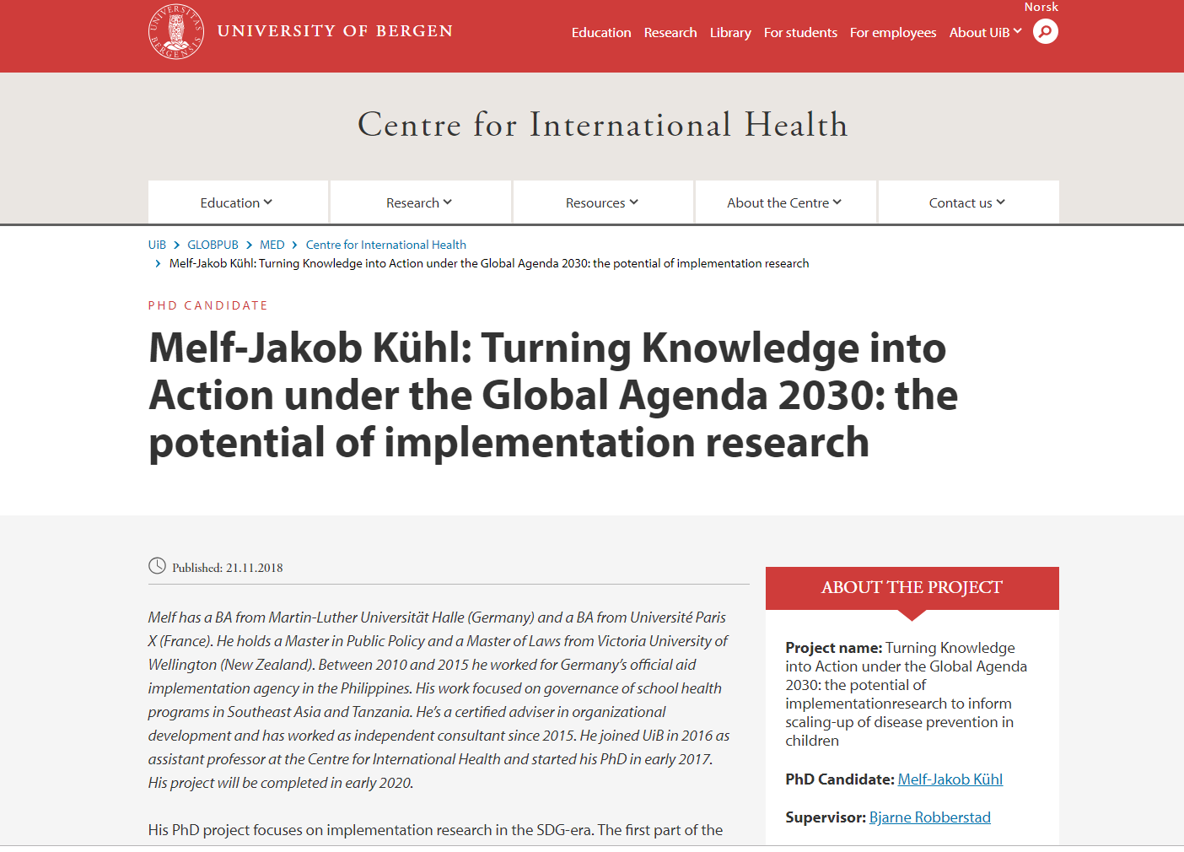
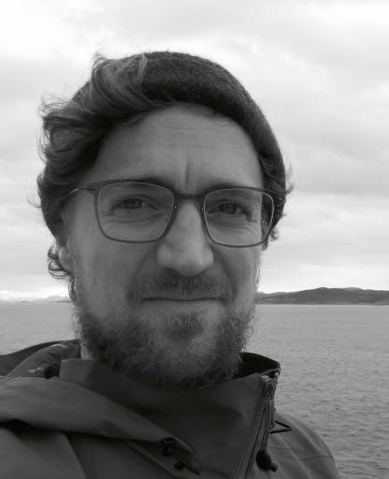
Global =Cross-cultural enjoyment
Implementation
research

Slide 22
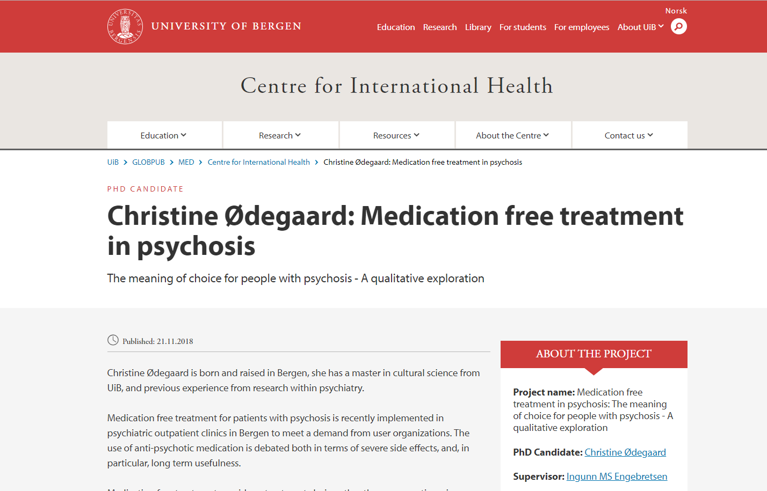

Implementation
Research
-ethnographic perspectives

Slide 23
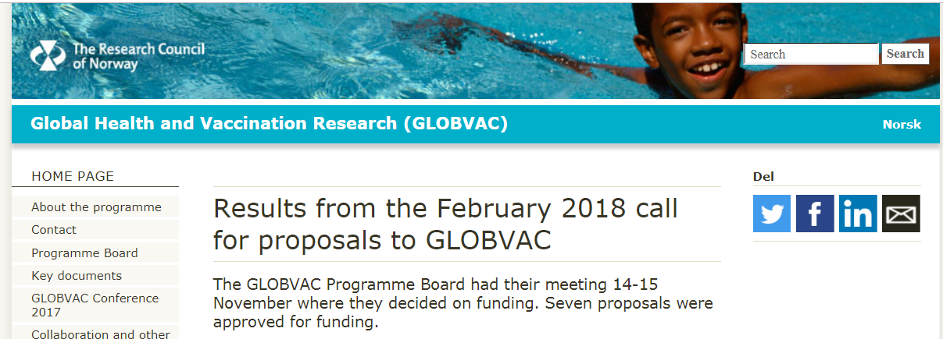
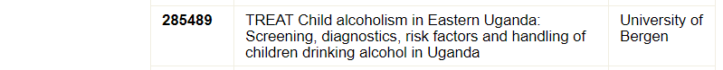
NEW RESEARCH PROJECT
Integrating perspecitves from
  user organisations
  MoH
  Clinicians
Quantiative and Qualitative methodologies
Epidemiological and clinical methods

Slide 24
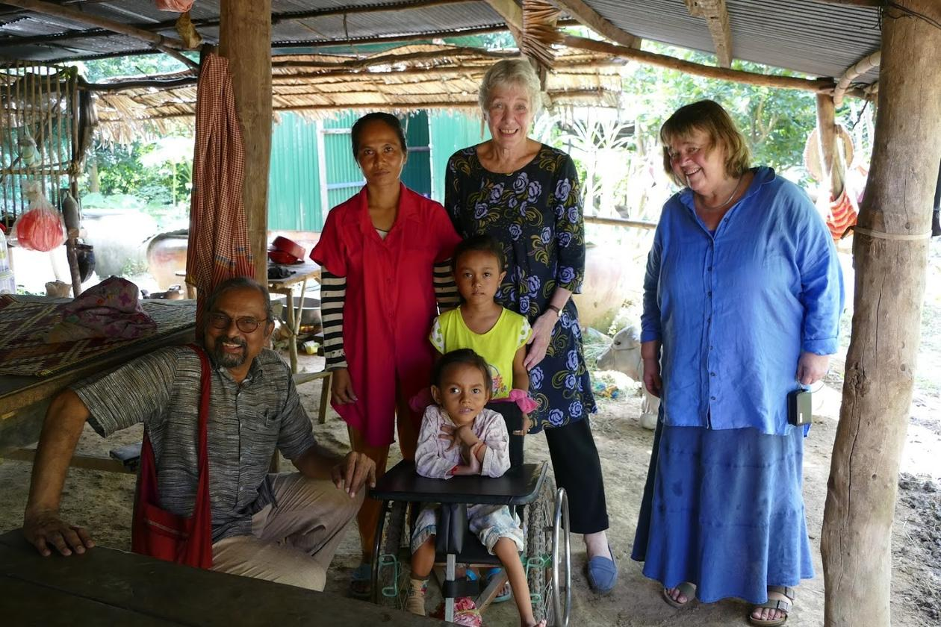
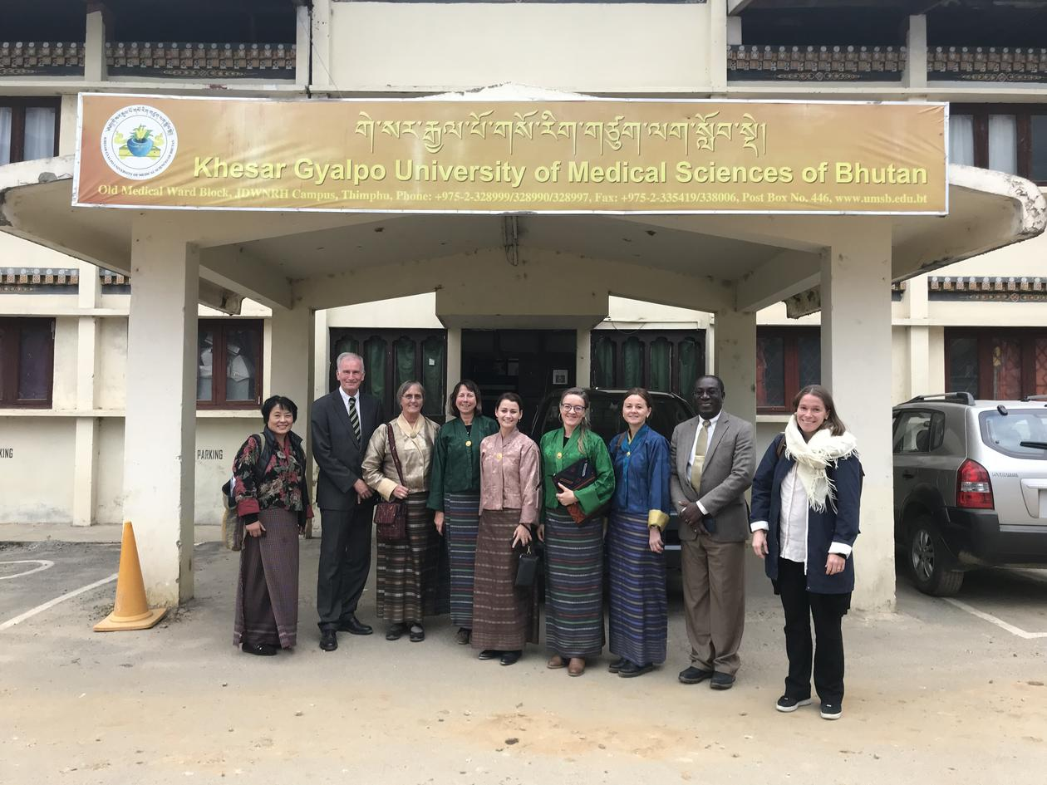
Building on existing networks
Cambodia
Bhutan

Slide 25
Concluding remarks
There is need for global mental health research (GMHR)
There are opportunities for GMHR
  Integration into existing other medical project
  Separate projects
  Some funding is coming with awareness
Competence and experience
  Cross-cultural
  Clinical
  Epidemiological
  Program implementation/operational

Slide 26


