Slide 1
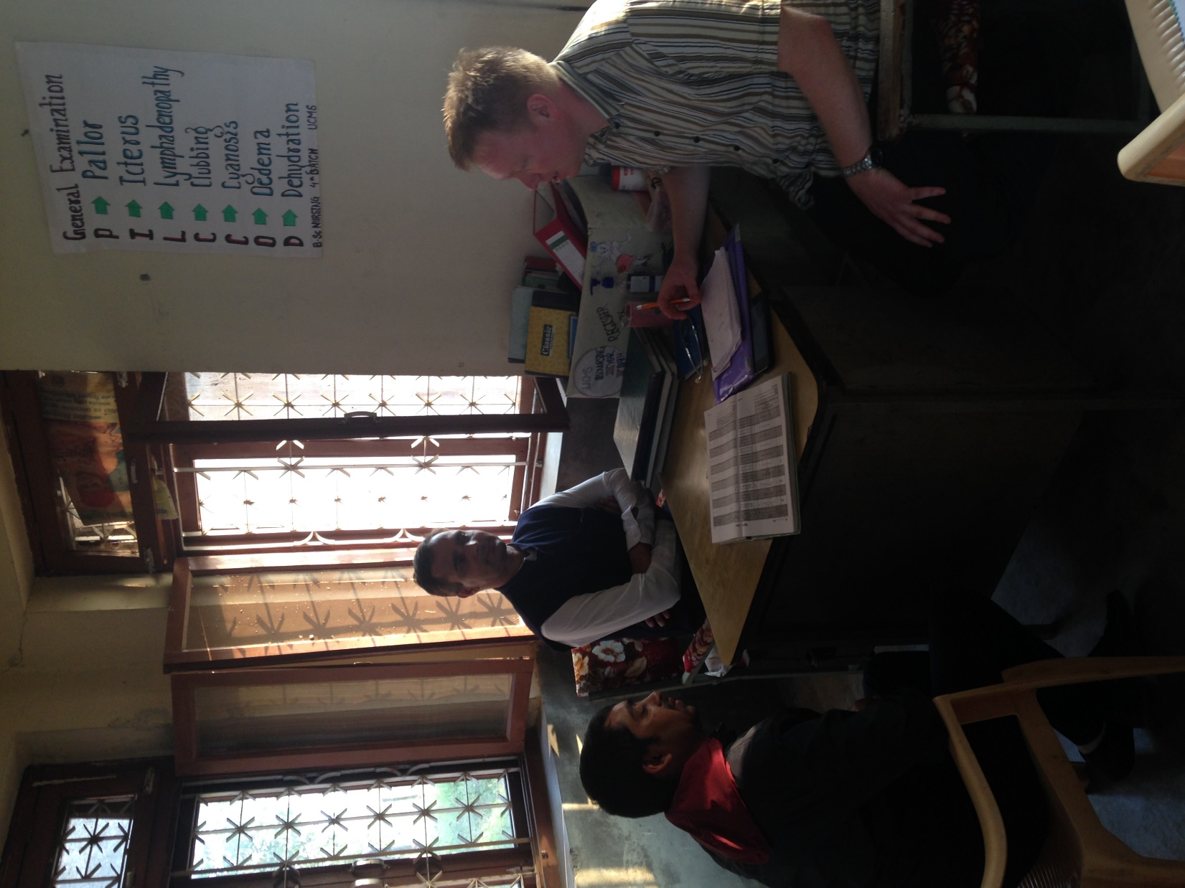
Ta utgangspunkt i konteksten
Tilgang til psykisk helse behandling på helsepostene i Nepal
Ingun Møgedal Brustugun

Slide 2
Goverment
University
UMN leadership team
Private medical colleges
National hospitals
UMN mental health team Kathmandu
Taranath Acharya - teamleader
Shristee Lamichane– program manager
Private IPD’s
Regional hospitals
(5) OPD and IPD
Zonal hospitals
(14) with psychiatric post
OPD and IPD
UMN cluster office
Local program officer
Private OPD’s
District health office (75)
Local NGO
Project coordinator
Private psychiatrists and psychologists
District hospitals (75) OPD
VDC health facility with 9 wards
NGO’s and INGO’s
FCHV from all wards in VDC
ANM
Health workers
Psychosocial worker
Traditional healers

Slide 4
Merverdi?

Slide 5
Tilnærming

Slide 6
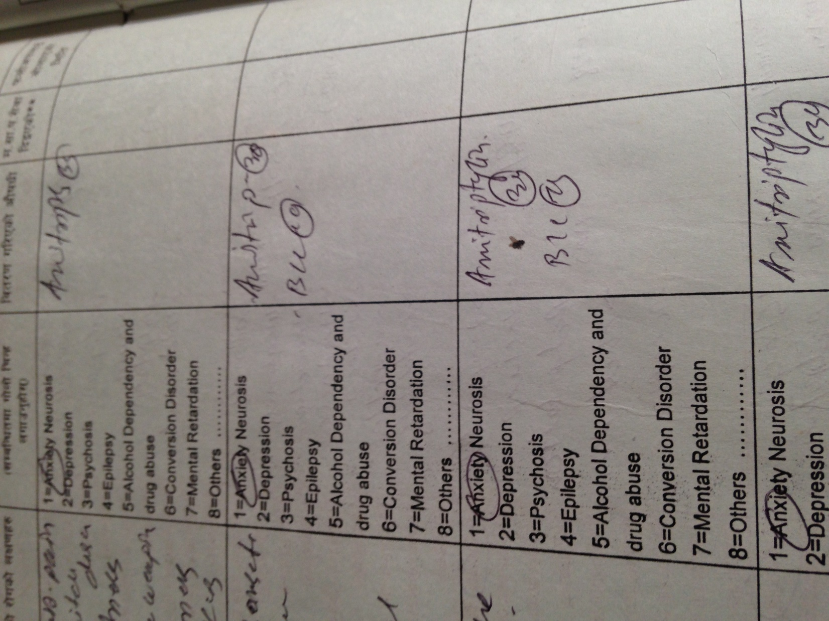
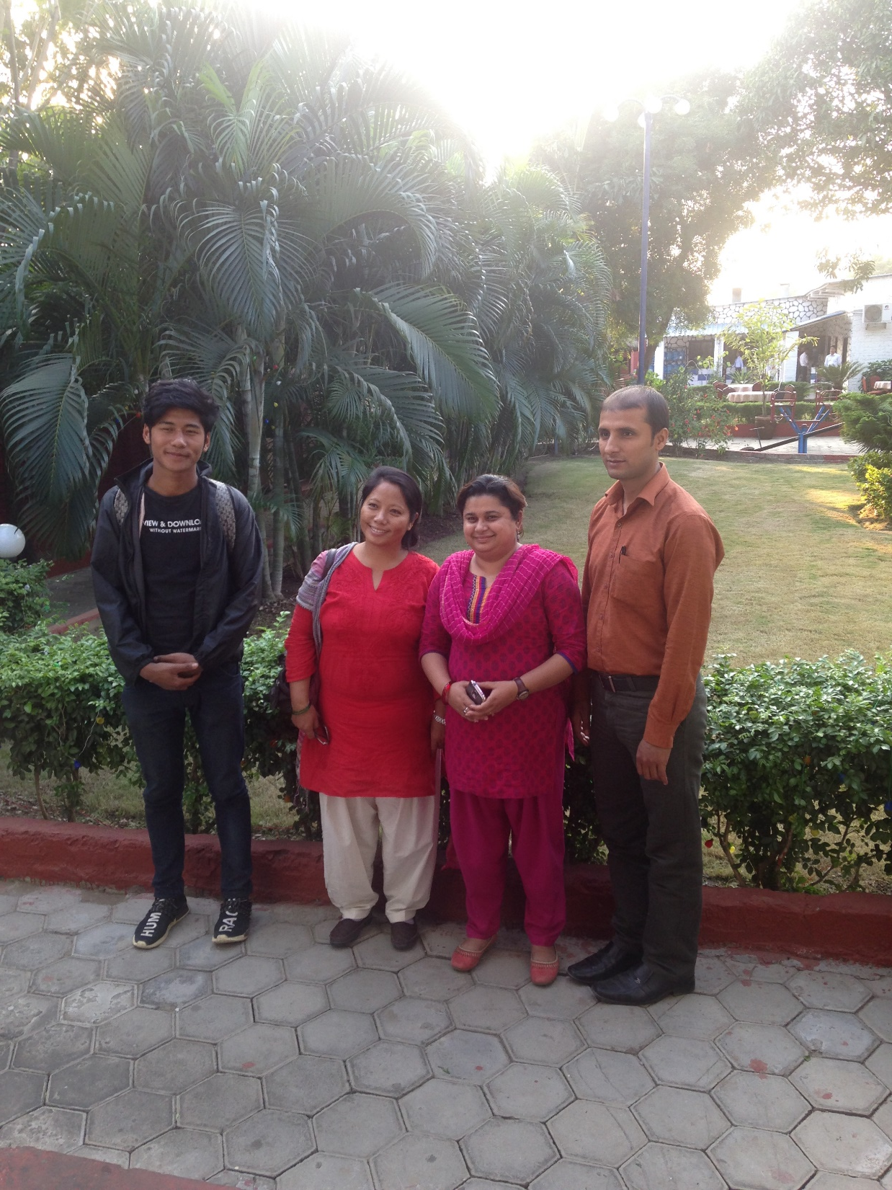

Slide 7
Psykososial støtte

Slide 8
Hva med barna?

